Slide 1


Linus Henning
07.09.2022

Slide 2

Outline
Executive Summary
Introduction
Methodology
Results
Conclusion
Appendix

Slide 3
Executive Summary
Summary of methodologies
Import data (API, Wikipedia)
Manipulate data (cleaning, wrangling)
Analyze data (SQL, Dash,Folium)
Predict data (ML)
Summary of all results
Interactive Dashboard
Exploratory Analysis
Prediction via ML models

Slide 4
Introduction
Project background and context
SpaceX wants to revolutionize space expeditions. They try to achieve that, by reusing rockets after the launch. In theory with this way it is possible to cut 100 million dollar from the total cost. We want to get a better look at this project, crunch some numbers and find out how viable this approach is and will be.
Problems you want to find answers
Predict successful return of rockets
Understand variables that impact that result

Slide 5

Section 1

Slide 6
Methodology
Executive Summary
Data collection methodology:
Split in two parts:
SpaceX API: SpaceX provides data about all their launches. Request data from API.
Wikipedia: Holds additional information about Falcon9. Web scrap website.
Perform data wrangling
Standard cleaning of data (NaN, …) and one-hot encoding for prediction
Perform exploratory data analysis (EDA) using visualization and SQL
Perform interactive visual analytics using Folium and Plotly Dash
Perform predictive analysis using classification models
Sklearn package: We build KNN, SVM, DT and LR and compare accuracy

Slide 7
Data Collection
SpaceX API
We send a get request to the SpaceX API.
In return we get a json file containing all the relevant data.
We transform data to useful fromat
Web Scraping
Web scraping is done by getting a http response from the website (Wikipedia).
We then parse that response and transform it to a useful format.
https://github.com/linushen/coursera_final_cap/blob/main/Collection_API.ipynb

Slide 8
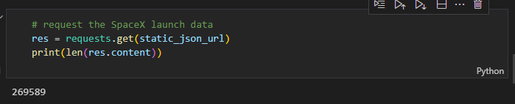
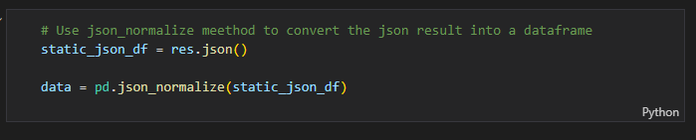
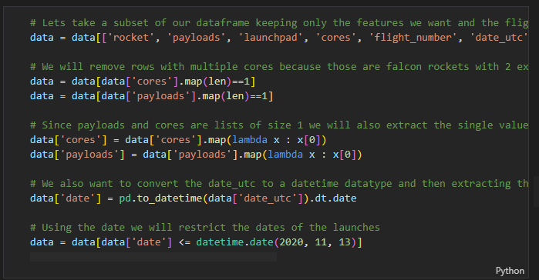
Data Collection – SpaceX API
Request API: send request to API
Normalize: transform data to json format
Restrict data: choose parts of data that we want to analyze

Slide 9
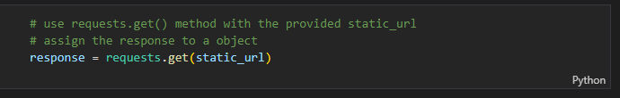
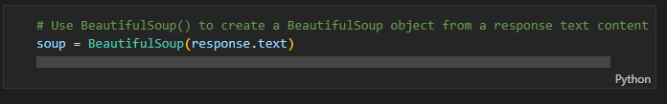
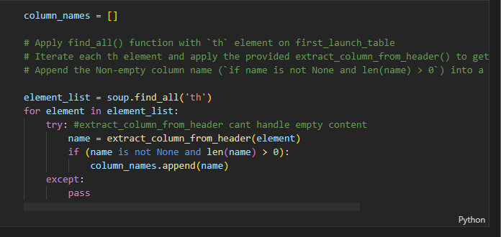
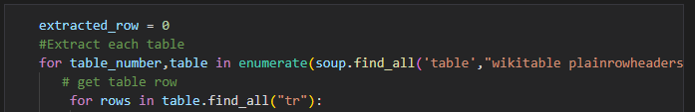
Data Collection - Scraping
Request: Send request to website. Returns https response
Parse: Parse object with beautiful soup
Filter: Filter column names
Iterate and create DataFrame

Slide 10
Data Wrangling
We created extra features (count launches, …)
We filled all null values
We also created an extra label for outcome
Count launches per site
Count outcomes per orbit
Count occurences per orbit
Fill NaN

Slide 11
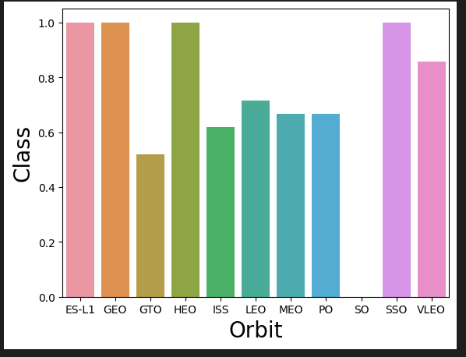
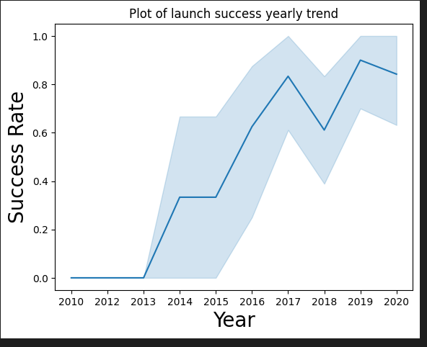
EDA with Data Visualization
We created plots that help us understand the relationship between e.g. success rate and orbit type or to see trends in the data
https://github.com/linushen/coursera_final_cap/blob/main/EDA_Visual_SNS.ipynb

Slide 12
EDA with SQL
SQL queries included:
List of unique launch sites
Total payload mass carried by booster
Find booster with success in drone ship
Total number of successful mission outcomes
https://github.com/linushen/coursera_final_cap/blob/main/EDA_SQL.ipynb

Slide 13
Build an Interactive Map with Folium
We created a folium map and added markers. This include:
Circles (To highlight location of launch site)
Marker (To show name of launch site)
Marker cluster (To show amount of successful missions for each launch site)
Lines (To show the closest coastline)
https://github.com/linushen/coursera_final_cap/blob/main/Folium.ipynb

Slide 14
Build a Dashboard with Plotly Dash
Summarize what plots/graphs and interactions you have added to a dashboard
Explain why you added those plots and interactions
Add the GitHub URL of your completed Plotly Dash lab, as an external reference and peer-review purpose

Slide 15

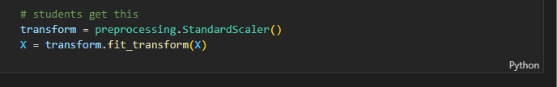

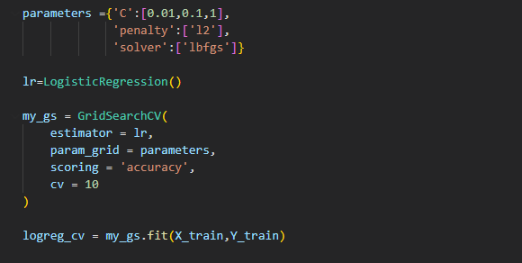

Predictive Analysis (Classification)
Load data: load data into dataframe
Scale data: scale data for better performance
Split data: split into train and test set
GridSearch: perform gridsearch for each model
Score: calculate the score for the best model from the GridSearch
Compare scores of models to find best overall model
https://github.com/linushen/coursera_final_cap/blob/main/Prediction.ipynb

Slide 16
Results
Exploratory data analysis results
Interactive analytics demo in screenshots
Predictive analysis results

Slide 17

Section 2

Slide 18
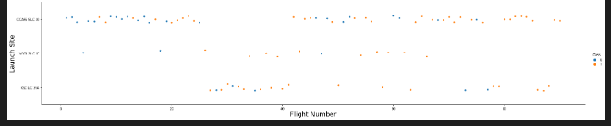
Flight Number vs. Launch Site
On the x-axis are the flight numbers and on the y-axis are the names of each launch site. The color indicates if the mission was successful or not (orange/blue).

Slide 19
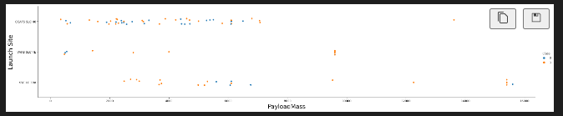
Payload vs. Launch Site
On the x-axis are the payload mass and on the y-axis are the names of each launch site. The color indicates if the mission was successful or not (orange/blue).

Slide 20
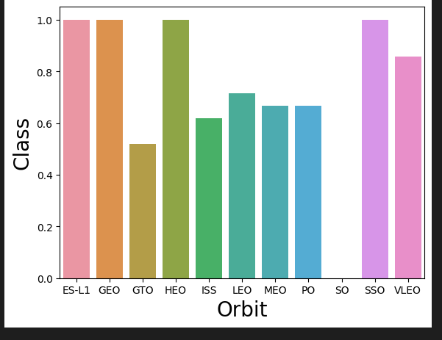
Success Rate vs. Orbit Type
On the x-axis are the Orbits and on the y-axis you can see the average successrate.

Slide 21
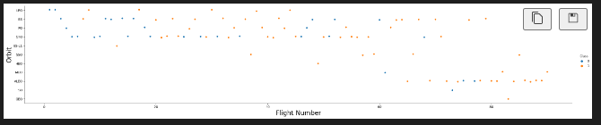
Flight Number vs. Orbit Type
On the x-axis are the flight numbers and on the y-axis are the different orbits. The color indicates if the mission was successful or not (orange/blue).

Slide 22
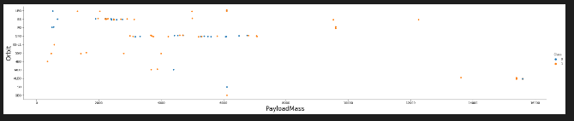
Payload vs. Orbit Type
On the x-axis is the payload mass and on the y-axis are the different orbits. The color indicates if the mission was successful or not (orange/blue).

Slide 23
Launch Success Yearly Trend
On the x-axis are the years and on the y-axis are the successrate. The blue line shows the average success for each year and the buffer shows the range of max and min.

Slide 24
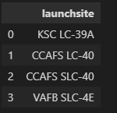
All Launch Site Names
Find the names of the unique launch sites
Use “DISTINCT” to get all unique ls

Slide 25
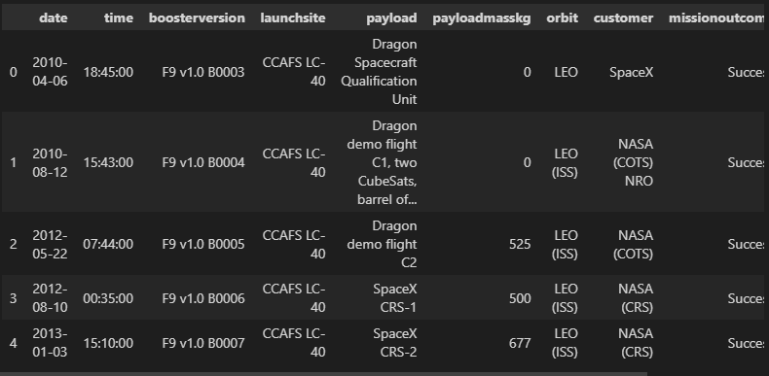
Launch Site Names Begin with 'CCA'
Find 5 records where launch sites begin with `CCA`
Use “WHERE” statement to specify that ls have to start with “CCA”

Slide 26
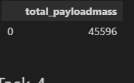
Total Payload Mass
Calculate the total payload carried by boosters from NASA
Use simple “SUM” to calculate total payload

Slide 27
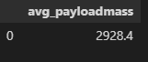
Average Payload Mass by F9 v1.1
Calculate the average payload mass carried by booster version F9 v1.1
Similar to task before, but use “AVG” instead of “SUM” and specify the boosterversion = F9 v1.1

Slide 28
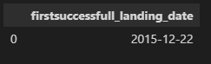
First Successful Ground Landing Date
Find the dates of the first successful landing outcome on ground pad
As stated in hint, we can use “MIN” on dates to get the earliest date of successful landing

Slide 29
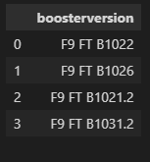
Successful Drone Ship Landing with Payload between 4000 and 6000
List the names of boosters which have successfully landed on drone ship and had payload mass greater than 4000 but less than 6000
Just use “AND” in the “WHERE” statement to specify the correct range (4000<x<6000)

Slide 30

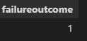
Total Number of Successful and Failure Mission Outcomes
Calculate the total number of successful and failure mission outcomes
We “COUNT” all successful/unsuccessful outcomes

Slide 31
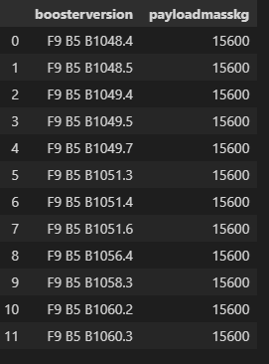
Boosters Carried Maximum Payload
List the names of the booster which have carried the maximum payload mass
We can use subquery to filter for the “MAX” payload mass

Slide 32
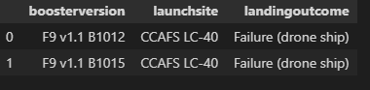
2015 Launch Records
List the failed landing_outcomes in drone ship, their booster versions, and launch site names for in year 2015
Use “BETWEEN” to specify the range of dates we want to allow

Slide 33
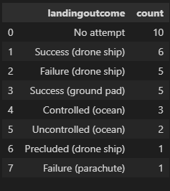
Rank Landing Outcomes Between 2010-06-04 and 2017-03-20
Rank the count of landing outcomes (such as Failure (drone ship) or Success (ground pad)) between the date 2010-06-04 and 2017-03-20, in descending order
Similar to task before but we also “GROUP BY” landing outcomes

Slide 34

Section 3

Slide 35
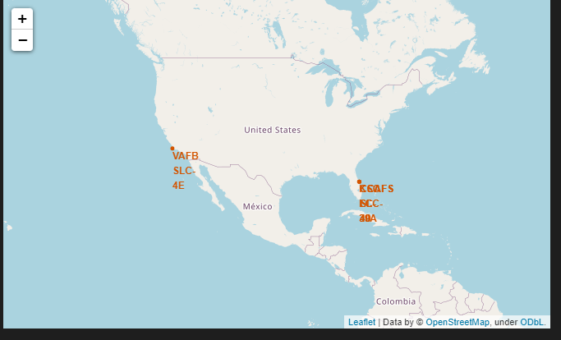
Initial Map
We can see that there are only two areas were the launch sites are located. One on the west- and one on the east coast. Launch sites are highlighted with marker

Slide 36
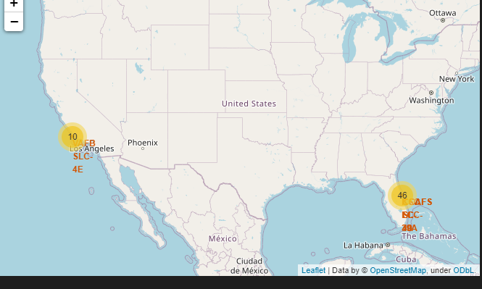
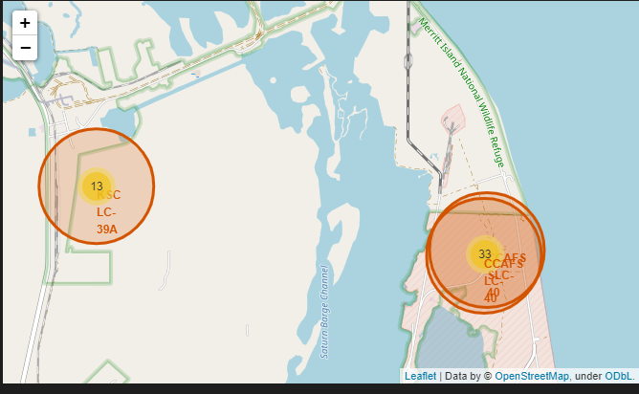
Map with outcome representation
In addition to the first map, we know can also see if the launch was successful or not. If we zoom in more we can see the different launch sites. We used marker cluster.

Slide 37
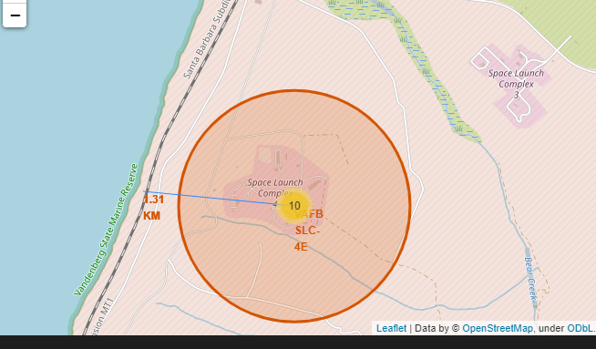
Map with distances
Now we can also see the distance to important points on the map. In this screenshot for example we see the distance from launch site to the closest railroad (1,31 KM).

Slide 38

Section 4

Slide 39
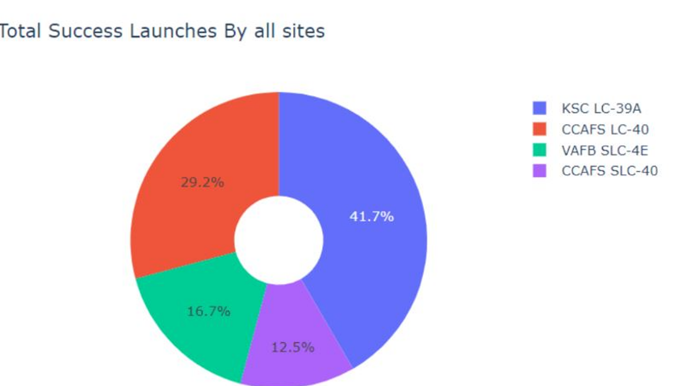
Piechart launch success
We can see the which launch site had the most successfull launches. It is easy to see that KSC performed the best

Slide 40
<Dashboard Screenshot 2>
Replace <Dashboard screenshot 2> title with an appropriate title
Show the screenshot of the piechart for the launch site with highest launch success ratio
Explain the important elements and findings on the screenshot

Slide 41
<Dashboard Screenshot 3>
Replace <Dashboard screenshot 3> title with an appropriate title
Show screenshots of Payload vs. Launch Outcome scatter plot for all sites, with different payload selected in the range slider
Explain the important elements and findings on the screenshot, such as which payload range or booster version have the largest success rate, etc.

Slide 42

Section 5

Slide 43
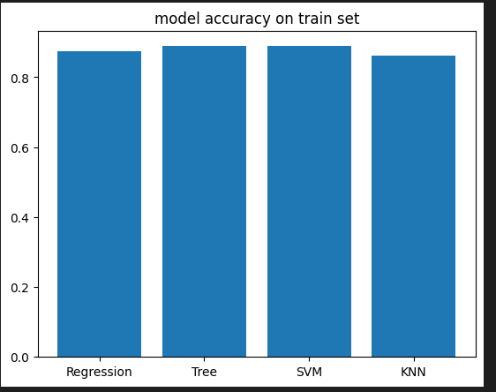
Classification Accuracy
In the plot we can see that the TREE and the SVM models are the best performing models (0.8888)

Slide 44
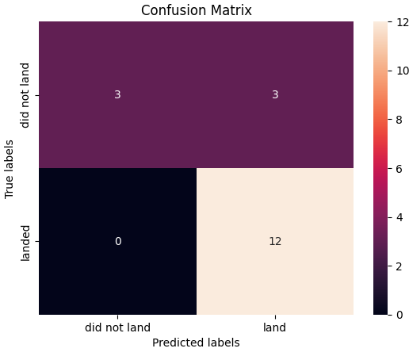
Confusion Matrix
We can take a look at the confusion matrix of the best performing model (SVM). The matrix shows how many labels are correctly predicted (land vs. not landed)

Slide 45
Conclusions
We managed to get a better understanding of the data and put it into a from (folium, …) that other people can understand as well.
Our models to predict the outcome performed well, but we should keep in mind that the data was very small.

Slide 46
Appendix
Include any relevant assets like Python code snippets, SQL queries, charts, Notebook outputs, or data sets that you may have created during this project

Slide 47


